Slide 1

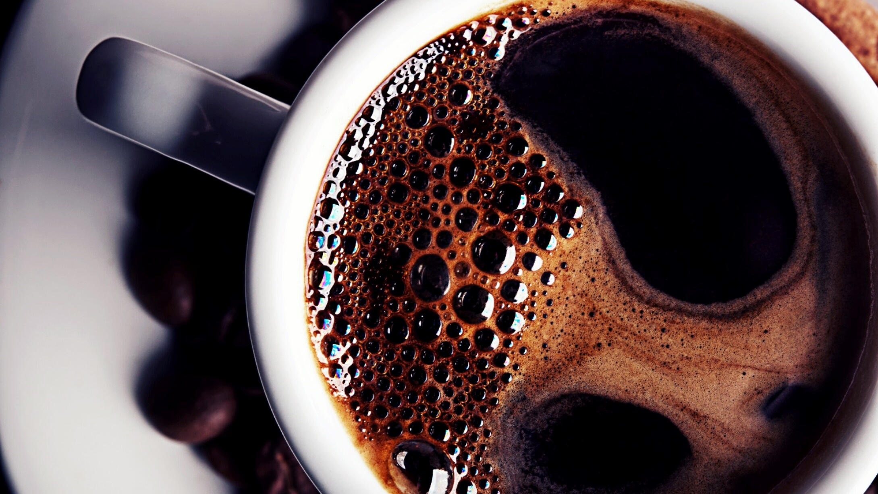
HUMAN TASK RECOGNITION
FINAL REVIEW
AVULA.ROHITHA 17BLC1007
K.MADHU SWAPNIKA 17BLC1024
AARTHI G 17BLC1166
CSE3019 DATA MINING
FACULTY: Dr.ANUSHA K

Slide 2
OBJECTIVE
The aim of this project is to create a model that can identify the basic human actions like running, jogging, walking etc. The model will be given a set of videos where in videos, a person will be performing an action. The label of a video will be the action that is being performed in that particular video.
This project uses DataMining techniques for Video Recognition - given a set of labelled videos, train a model so that it can give a label/prediction for video. Here, the label might represent what is being performed in the video, or what the video is about.

Slide 3
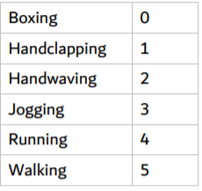
DATA EXPLORATION
The video dataset contains actions like jogging, running and walking etc in 4 different scenarios.
Link for Dataset: https://www.csc.kth.se/cvap/actions/
The dataset contains 599 videos – 100 videos for each of the 6 categories (with the exception of Handclapping having 99 videos).
While loading the data, we convert these text labels into integers according to the following mapping:

Slide 4
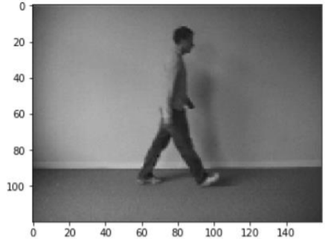
DATA VISUALIZATION
Below is a single frame of a sample video of walking
It can be observed that the spatial dimensions of the video (width x height) are 160 x 120 pixels. Also, on loading a single video into a NumPy array in python, the shape of the array obtained was – (1, 515, 120, 160, 3) This indicates that:
There is 1 video
The video has 515 frames
The spatial dimension of the video is 160 x 120 (width x height) pixels
Each frame has 3 channels – Red(R), Green(G) and Blue(B) A similar methodology would be used for reading in the entire dataset.

Slide 5
METHODOLOGY
Data pre-processing:
Reading the video frame-by-frame.
The videos were captured at a frame rate of 25fps.
Each frame needs to have the same spatial dimensions (height and width). Hence each frame in a video will have to be resized to the required size.
In order to simplify the computations, the frames are converted to grayscale
Normalization – The pixel values ranges from 0 to 255. These values would have to be normalized in order to help our model converge faster and get a better performance.
The categorical labels should be encoded using a technique called One-hot Encoding. One-hot Encoding converts the categorical labels into a format that works better with both classification and regression models.

Slide 6
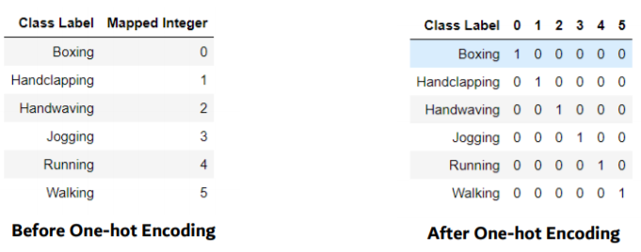
One of the most important part of the project was to load the video dataset and perform the necessary pre-processing steps. So, we developed a class (Videos) that had a function called (read_videos()) that can be used to for reading and processing videos.
We have used NumPy (wherever) for storage and processing of the videos (much faster than in-built python lists with a ton of extra functionalities).

Slide 7
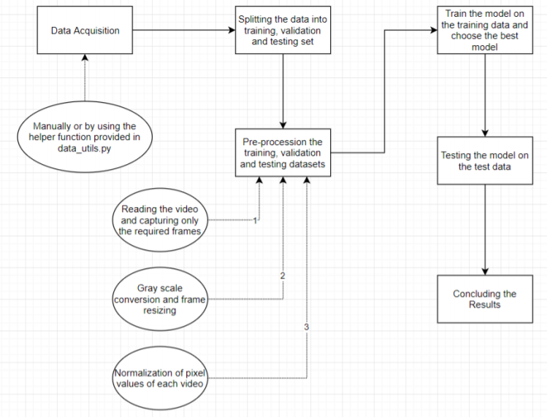
The model is trained on the training data repeatedly for a number of iterations. These iterations are known as epochs. After each epoch, the model is tested using the validation data.
Finally, the model that performed the best on the validation data is loaded.
The performance of this model is then evaluated using the test data.
Most accurate model will be used for identification of human actions.

Slide 8
ALGORITHMS AND TECHNIQUES
We already know that neural networks perform very well for image recognition. In particular, a specific type of neural networks called Convolutional Neural Networks (CNNs) are best suited for the task of image recognition.
CONVOLUTION NEURAL NETWORKS:
The image is divided into regions, and each region is then assigned to different hidden nodes. Each hidden node finds pattern in only one of the regions in the image. This region is determined by a kernel (also called a filter/window). A filter is convolved over both x-axis and y-axis. Multiple filters are used in order to extract different patterns from the image. The output of one filter when convolved throughout the entire image generates a 2-d layer of neurons called a feature map.These feature maps can be stacked into a 3-d array, which can then be used as the input to the layers further. This is performed by the layer known as Convolutional layer in a CNN.

Slide 9
These layers are followed by the Pooling layers, that reduce the spatial dimensions of the output.In short, a window is slid in both the axes and the max value in that filter/window is taken (MaxPooling layer). Sometimes Average pooling layer is also used where the only difference is to take the average value within the window instead of the maximum value. Therefore, the convolutional layers increase the depth of the input image, whereas the pooling layers decreases the spatial dimensions (height and width). The importance of such an architecture is that it encodes the content of an image that can be flattened into a 1-dimensional array. We discussed how CNNs can be used in case of images. What we use is specifically known as 2-d convolutional layers and pooling layers. It’s 2-dimensional because the filter is convolved along the x-axis and y-axis of the image. But in case of a video, we have an additional temporal axis – z-axis. So, a 3-d convolutional layer is used – where the filter (also 3-dimensional) is convolved across all the three axes. Multiple convolutional and pooling layers are stacked together. These are followed by some fully-connected layers, where the last layer is the output layer. The output layer contains 6 neurons (one for each category). The network gives a probability of an input to belong to each category/class.

Slide 10
Logistic regression
Logistic regression helps to describe data and explain the relationship between one dependent binary variable and one or more independent variables. Logistic regression models give unchanging values for the descriptive variables if based on a least of about 10 events per explanatory variable. “Event” signifies the cases fit into the less frequent class in the dependent variable.
This algorithm is imported as LogisticRegression() followed by the fit() method which models the algorithm on the data provided. We used the predict() method to predict the outputs of the test data, X_test and store it in prediction variable.
Then we used the accuracy_score function to calculate the accuracy, which takes the first argument as true values and second argument as prediction.
Finally multiplied it by 100 to convert into percentage.
We do the same steps for each algorithm.

Slide 11
K-MEANS CLUSTERING
K-means clustering is one of the simplest unsupervised learning algorithms that solve the well-known clustering problem.
This algorithm is imported as Kmeans().
The algorithm is composed of the following steps:
1) Place K points into the space represented by the objects that are being clustered. These points represent initial group centroids.
2) Assign each object to the group that has the closest centroid.
3)When all objects have been assigned, recalculate the positions of the K centroids.
4)Repeat Steps 2 and 3 until the centroids no longer move. This produces a separation of the objects into groups from which the metric to be minimized can be calculated.

Slide 12

SUPPORT VECTOR MACHINE
SVM is one of the most popular, versatile supervised machine learning algorithms.
The human activities recognition are formulated by multiclass classification problem. Each activity is represented by each class. The goal is assigning and classifying a video sequence to classes of activities. Many supervised learning methods are learned to activity recognizer. Support Vector Machine (SVM) is one of the superior machine learning in human activity recognition and high dimensional data because the prime generalization strength and highly accurate results. SVM can avoid over-fitting in neural networks
A necessary requirement for action recognition using the local feature kernel In the given equation is the match between corresponding features in different sequences.
This algorithm is imported as ()
SVM classification combined with motion descriptors in terms of local features (LF) and feature histograms (HistLF) define two novel methods for motion recognition. SVM outperformed KNN, gave the better performance.

Slide 13
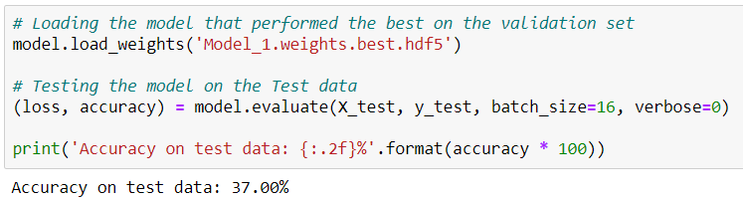
MODEL 1
The model was trained on the training data for 40 epochs. The weights of the model which gave the best performance on the validation data were loaded. The model was then tested on the test data.
The model gave an accuracy of 37% on the test data.

Slide 14
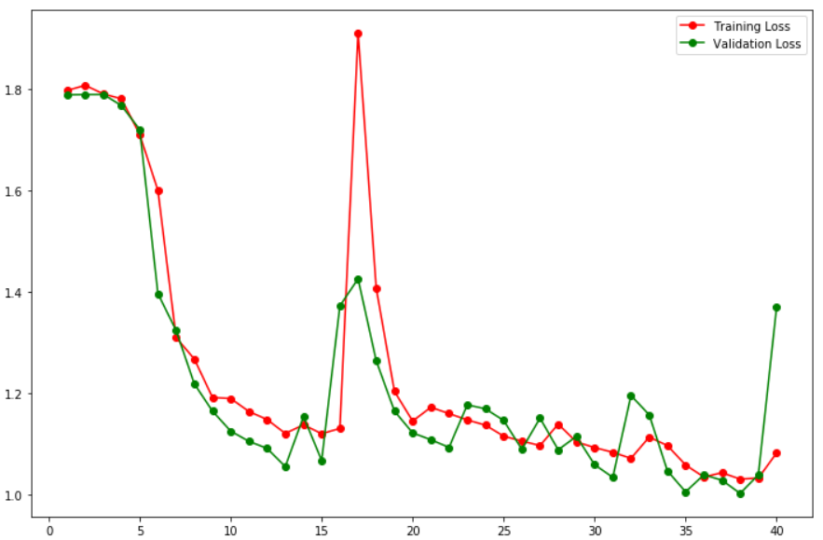
MODEL1 CURVE

Slide 15
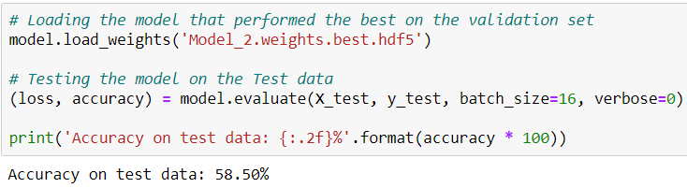
MODEL 2
In order to prevent overfitting, there is a method called Dropout.
In this model, I've added a dropout for the hidden layer (with 32 neurons) in the fully-connected layers. Rest of the model is same as Model-1.
The model gave an accuracy of 58.5% on the test data. So, just by adding a dropout layer, the model's accuracy increased by almost 22%. This shows that the dropout prevented our model from overfitting.

Slide 16
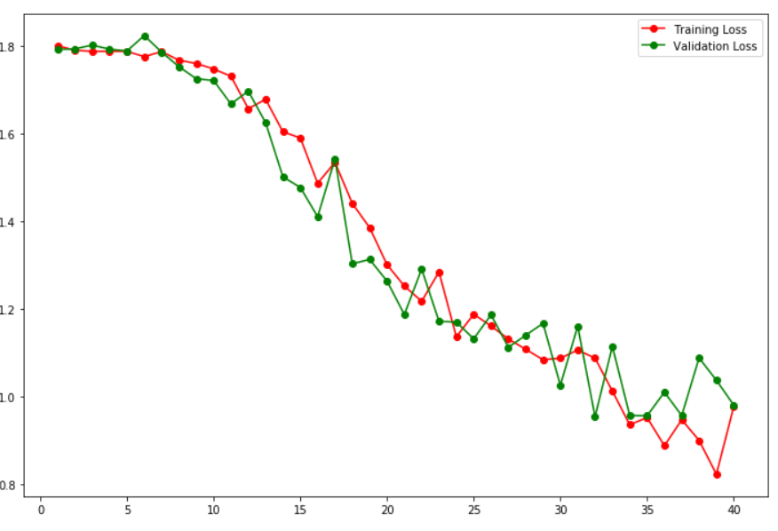
MODEL 2 CURVE

Slide 17
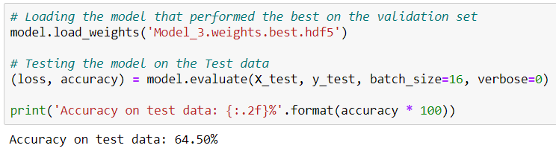
MODEL 3
Now, extracted only 5 frames per second (first 5 frames for each second). So, suppose we have a video of 10 seconds, we will get 10 x 5 = 50 frames.
The model gave an accuracy of 64.5% on the test data. This model gave a higher accuracy than the previous models, despite using 5 times lesser data for training.
In this model, another pair of convolutional and max pooling layer was added. This made the output of the final convolutional layer to have a depth of 1024 (earlier it was 256).

Slide 18
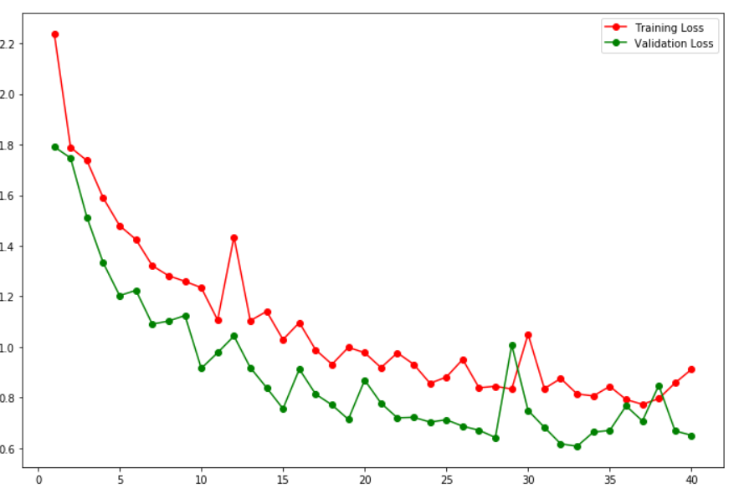
MODEL 3 CURVE

Slide 19
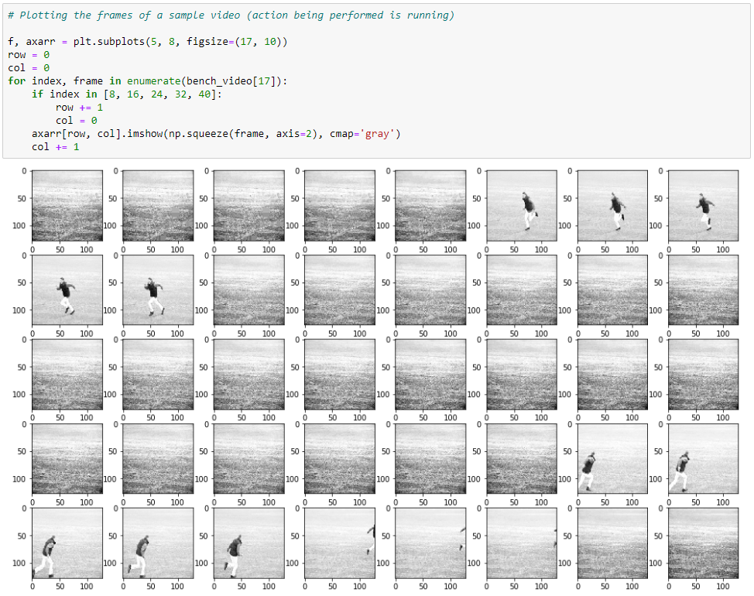
RESULTS

Slide 20
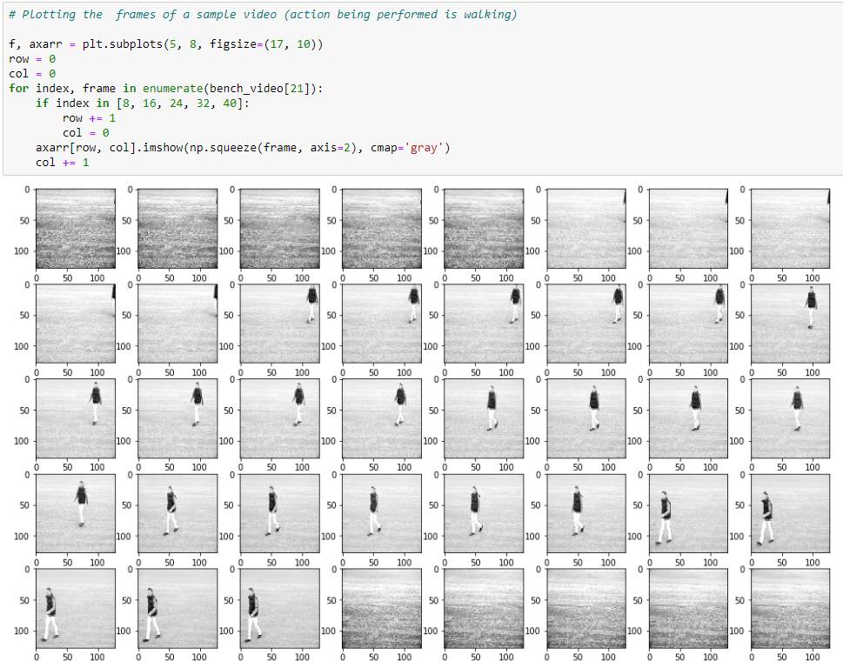
WALKING

Slide 21
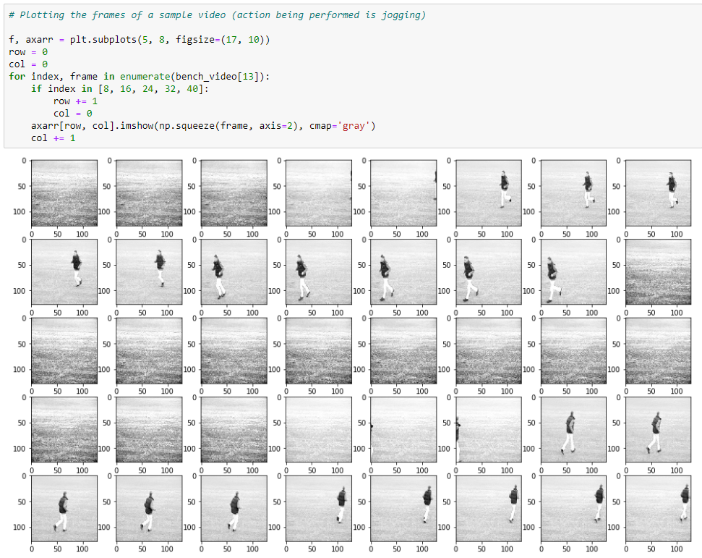
JOGGING

Slide 22
FUTURE WORK
A simple web-application could have been developed, where the user can perform some action. This would be captured by a webcam and the model would give real-time predictions of the action being performed.
Learning the patterns involved in the movement of humans . If we are able to create a model that can learn how we (humans) perform various activities (like walking, running, exercising etc.), we can use this model for proper functioning of the movement mechanisms in autonomous robots

Slide 23
REFERENCES
What is Deep Learning?
Metrics to evaluate CV algorithms
Intro to Neural Networks
Convolutional Neural Networks
Confusion Matrix Terminology

Slide 24
THANK YOU !

